Slide 1
School Call Update
October 30, 2024

Slide 2
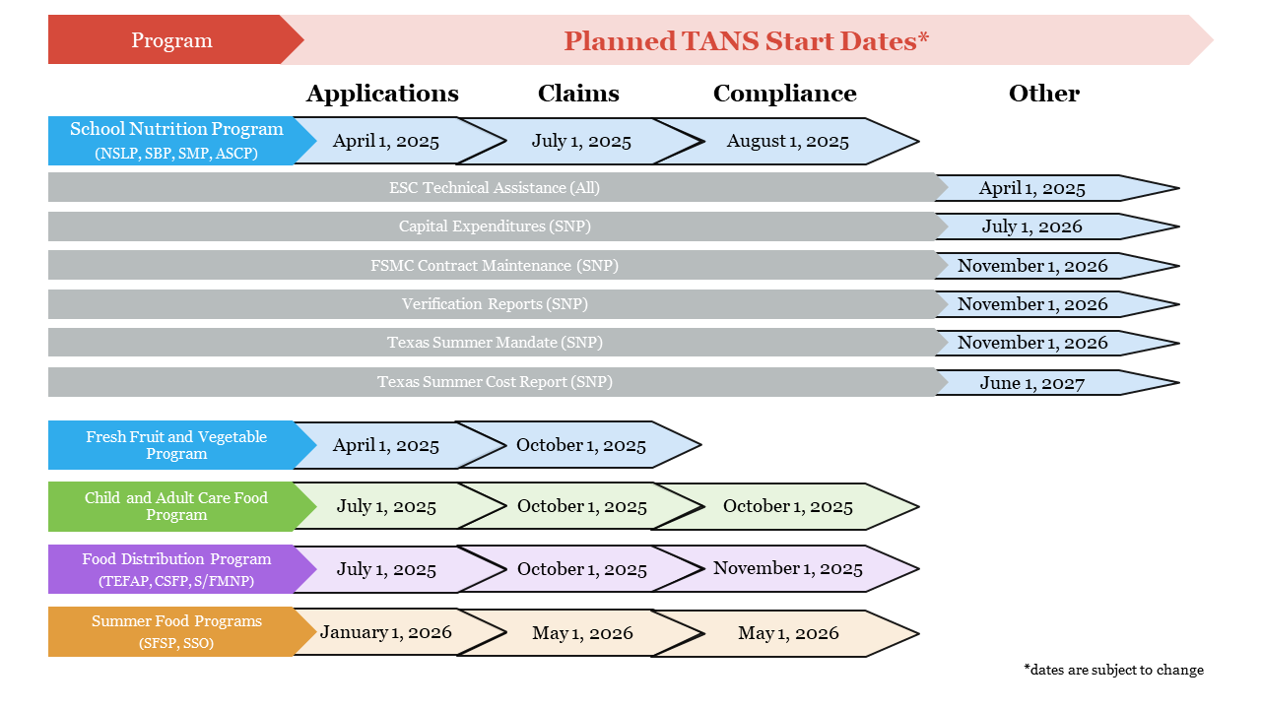
TANS Start Dates

Slide 3
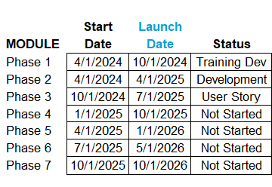
Development Update

Slide 4
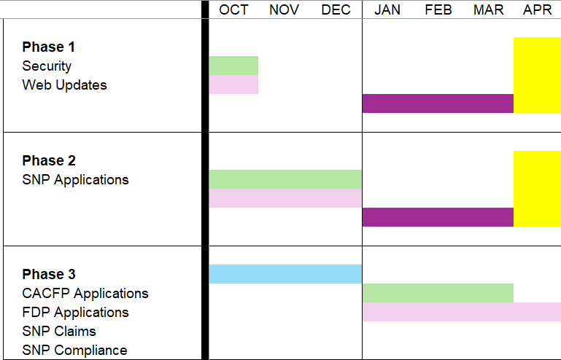
Development Update
System Requirements
Gathering details of system updates and enhancements needed
Development
Updates and enhancements to TANS are in progress.
Training Creation
Training materials are being developed alongside the TANS application.
Training Delivery
Phase 1 & 2 training will begin in January through March. State and ESC users will be trained first.
TANS goes LIVE!
SNP Applications will launch April 1 to begin PY2026 applications.

Slide 5
TANS Talk
YOU’RE INVITED
Please join us in our very first TANS Talk!
WHEN: November 7th 1PM – 2PM CST
WHERE: Zoom
WHAT: TANS Security, FAQs, TANS Talk Feedback Log
Feedback Form can be used to add any questions you would like to see covered during the call.

Slide 6
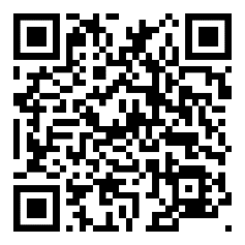
Resources
TANS on SquareMeals
Timelines, updates, and more
Training resources will be housed here as they become available.
Previous Presentations
Feedback Form
Accessible under “Contact Us”
Submit your questions, concerns, and other feedback to help us improve our communication and resources supporting the TANS transition
Timelines
Frequently Asked Questions
Covers questions on the timeline, training, data and reporting, and more.

Slide 7
Thank you!

